Slide 1

Loss functions
KIET Group of Institutions

Slide 2
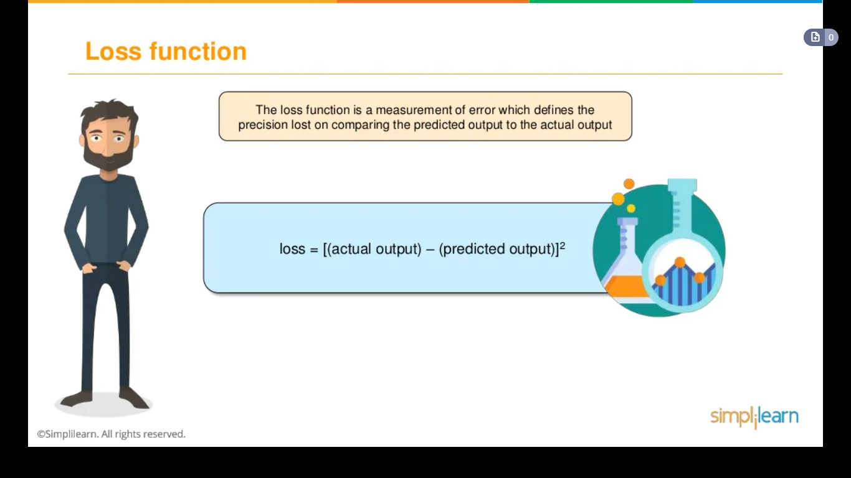
LOSS FUNCTION

Slide 3
TYPES OF LOSS FUNCTION
Loss functions are mainly classified into two different categories that are Classification loss and Regression Loss.
Classification loss is the case where the aim is to predict the output from the different categorical values for example, if we have a dataset of handwritten images and the digit is to be predicted that lies between (0-9), in these kinds of scenarios classification loss is used.
Whereas if the problem is regression like predicting the continuous values for example, if need to predict the weather conditions or predicting the prices of houses on the basis of some features. In this type of case, Regression Loss is used.

Slide 4
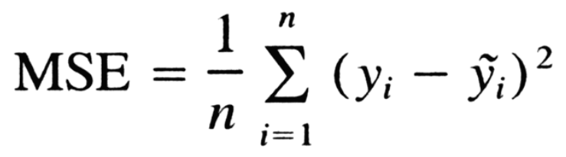
Regression Losses
Mean Square Loss : It is more often used regression loss that is computed by taking the average squared difference between actual and predicted observations. It mainly takes into consideration the average magnitude of error ignoring the direction. Due to squaring the predictions that are distant from the true values are penalized laboriously in comparison to less diverged predictions.

Slide 5
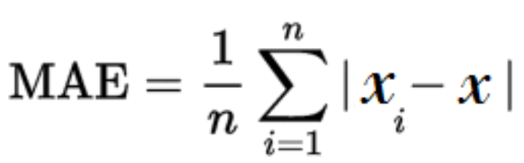
Regression Losses
Mean Absolute Error :It is computed by taking the average of the sum of absolute differences between the true and predicted variables. Similar to MSE it also calculates magnitude ignoring the direction. It is tough to compute the gradients in MAE as there is a need for linear programming also MAE does not use square so it is more strong to outliers.

Slide 6
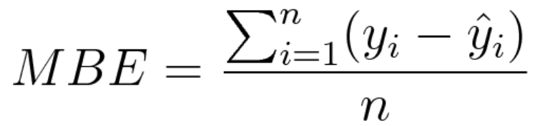
Regression Losses
Mean Bias Error: It is not that often used loss in regressions. MBE is almost similar to MSE, the only difference that makes them different is that absolute values are not taken here. It is less used but it can be used to check if the model has a negative bias or positive bias.

Slide 7
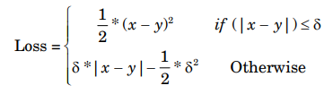
Regression Losses
Huber loss (smooth mean absolute error) : It is less sensitive to outliers in data than MSE and is also differentiable at 0. It is an absolute error, which becomes quadratic when the error is small.

Slide 8
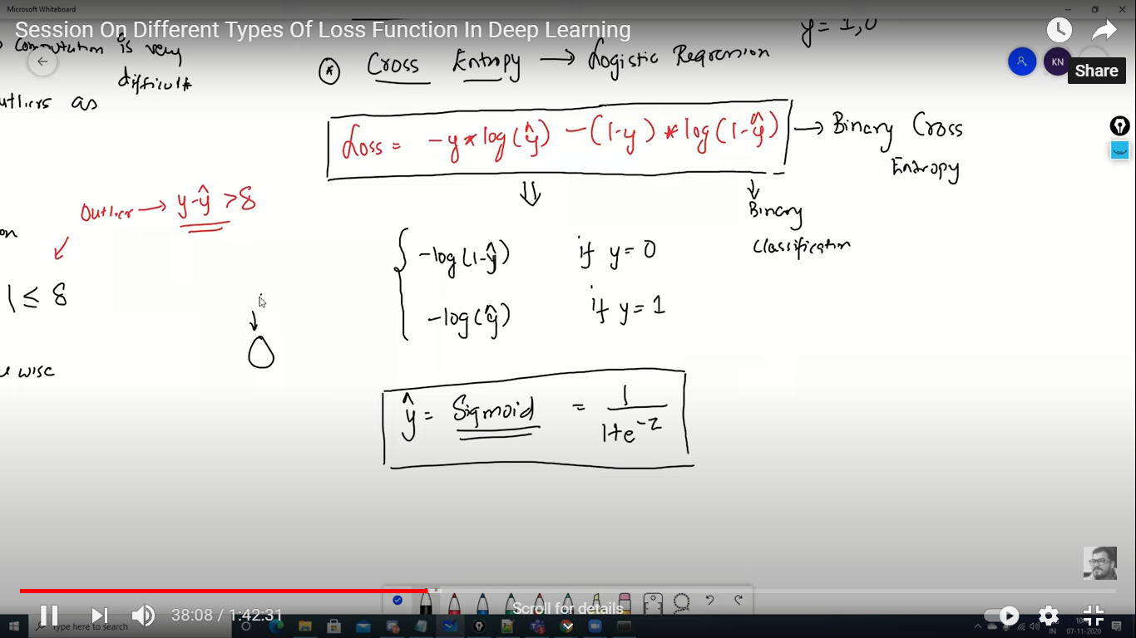
ClassificationLosses
Cross-Entropy Loss: It computes the performance of classification tasks where results lie between probability values 0 and 1. As the predicted probability disunites from the true label, the cross-entropy loss gets increased. Log loss of 0 is considered to be a perfect model. Both cross-entropy and log loss are a bit different from each other but when we are computing errors between 0 and 1, they result in the same thing.
Cross-Entropy Logistic Regression

Slide 9
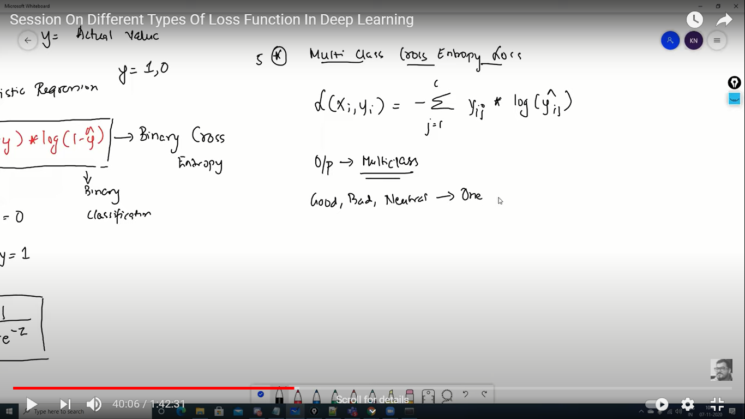
ClassificationLosses
Multiclass Cross-Entropy Loss:
For example we classify a dataset as Good, bad, neutral. Here we represented this using one hot encoding i.e. bits representation.

